Slide 1
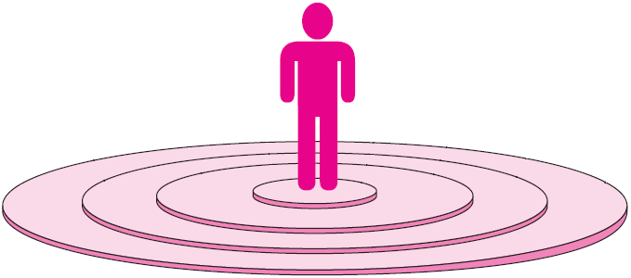
Personal Space in the U.S.
Intimate distance
18”
Personal distance
18” to 4’
Social distance
4’ to 8’
Public distance
8’ to 10’
Adapted from Figure 7–3: Personal Space Categories for Those in the United States

Slide 2

Personal Space in the U.S.
Public Distance
Personal Distance
Intimate Distance
Social Distance
8’- 16’
4’ - 8’
18” - 4’
18”

Slide 3
Intimate
Intimate
Intimate

Slide 4
Know What You Want
Know What They Want
Propose Action In A Way that They Can Accept

